Slide 1
Logic Gates

Slide 2


AND
In order for current to flow, both switches must be closed
  Logic notation A•B = C
  (Sometimes AB = C)
A | B | C
0 | 0 | 0
0 | 1 | 0
1 | 0 | 0
1 | 1 | 1

Slide 3


OR
Current flows if either switch is closed
  Logic notation A + B = C
A | B | C
0 | 0 | 0
0 | 1 | 1
1 | 0 | 1
1 | 1 | 1

Slide 4




Properties of AND and OR
Commutation
  A + B = B + A
  A • B = B • A
Same as
Same as

Slide 5
Properties of AND and OR
Associative Property
  A + (B + C) = (A + B) + C
  A • (B • C) = (A • B) • C
=

Slide 6
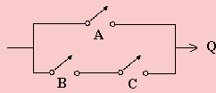
Properties of AND and OR
Distributive Property
  A + B • C = (A + B) • (A + C)
  A + B • C
A | B | C | Q
0 | 0 | 0 | 0
0 | 0 | 1 | 0
0 | 1 | 0 | 0
1 | 0 | 0 | 1
1 | 0 | 1 | 1
1 | 1 | 0 | 1
1 | 1 | 1 | 1

Slide 7

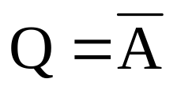
Inversion (NOT)
A | Q
0 | 1
1 | 0
Logic:

Slide 8

Exclusive OR (XOR)
Either A or B, but not both
This is sometimes called the inequality detector, because the result will be 0 when the inputs are the same and 1 when they are different.
The truth table is the same as for S on Binary Addition. S = A  B
A | B | S
0 | 0 | 0
1 | 0 | 1
0 | 1 | 1
1 | 1 | 0

Slide 9
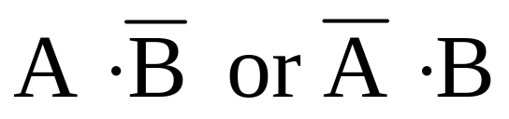
Getting the XOR
A | B | S
0 | 0 | 0
1 | 0 | 1
0 | 1 | 1
1 | 1 | 0
Two ways of getting S = 1

Slide 10
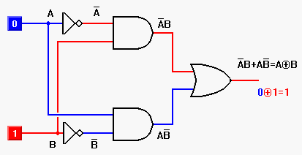
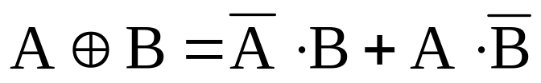
Circuit for XOR

Slide 11

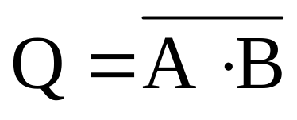
NAND (NOT AND)
A | B | Q
0 | 0 | 1
0 | 1 | 1
1 | 0 | 1
1 | 1 | 0

Slide 12

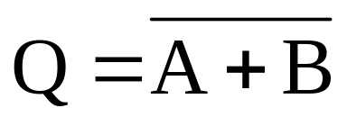
NOR (NOT OR)
A | B | Q
0 | 0 | 1
0 | 1 | 0
1 | 0 | 0
1 | 1 | 0

Slide 13
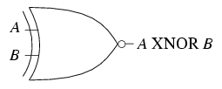
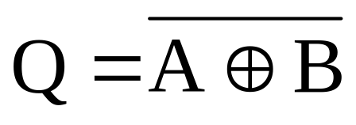
Exclusive NOR
A | B | Q
0 | 0 | 1
0 | 1 | 0
1 | 0 | 0
1 | 1 | 1
Equality Detector

Slide 14
Summary for Truth Tables
Summary for all 2-input gates
Inputs |  | Output of each gate
A | B | AND | NAND | OR | NOR | XOR | XNOR
0 | 0 | 0 | 1 | 0 | 1 | 0 | 1
0 | 1 | 0 | 1 | 1 | 0 | 1 | 0
1 | 0 | 0 | 1 | 1 | 0 | 1 | 0
1 | 1 | 1 | 0 | 1 | 0 | 0 | 1

Slide 15
Summary for Logic Gates

Slide 16






MORE LOGIC GATES
Try and work out the truth tables for these gates. The rule will help you.
AND
OR
XOR
A
A
A
Q
Q
Q
B
B
B
RULE: Q = 1 if A AND B =1
RULE: Q = 1 if A OR B =1
Q = 1 if A OR B =1, but NOT both
A | B | Q
0 | 0
0 | 1
1 | 0
1 | 1
A | B | Q
0 | 0
0 | 1
1 | 0
1 | 1
A | B | Q
0 | 0
0 | 1
1 | 0
1 | 1
NAND
NOR
NOT
A
A
Q
Q
A
Q
B
B
RULE: Q = 0 if A AND B =1
RULE: Q = 0 if A OR B =1
RULE: Q = 0 if A =1
A | B | Q
0 | 0
0 | 1
1 | 0
1 | 1
A | B | Q
0 | 0
0 | 1
1 | 0
1 | 1
A | Q
0
1

Slide 17
LOGIC GATES
AND
OR
XOR
A
A
A
Q
Q
Q
B
B
B
RULE: Q = 1 if A AND B =1
RULE: Q = 1 if A OR B =1
Q = 1 if A OR B =1, but NOT both
A | B | Q
0 | 0 | 0
0 | 1 | 0
1 | 0 | 0
1 | 1 | 1
A | B | Q
0 | 0 | 0
0 | 1 | 1
1 | 0 | 1
1 | 1 | 1
A | B | Q
0 | 0 | 0
0 | 1 | 1
1 | 0 | 1
1 | 1 | 0
NAND
NOR
NOT
A
A
Q
Q
A
Q
B
B
RULE: Q = 0 if A AND B =1
RULE: Q = 0 if A OR B =1
RULE: Q = 0 if A =1
A | B | Q
0 | 0 | 1
0 | 1 | 1
1 | 0 | 1
1 | 1 | 0
A | B | Q
0 | 0 | 1
0 | 1 | 0
1 | 0 | 0
1 | 1 | 0
A | Q
0 | 1
1 | 0

